Slide 1
ANALYSIS ON THE COST REDUCTION OF PRODUCT INVENTORY BY USING MARKET BASKET AND PARETO ANALYSISB
ASKET ANALYSIS
METHODOLOGY DOCUMENTS
PROBLEM STATEMENTS
OList is an e-commerce company that has faced some losses recently and they want to manage their inventory very well so as to reduce any unnecessary costs.
With the emergence of the e-commerce in the industry, it is very important for them to plan their inventory accordingly without storing tons of products.
BY AKANKSHA SHARMA

Slide 2
OBJECTIVE:
To gather some important insights for the company to reduce their inventory cost by focusing on the Market Basket Analysis
To analyse and improve our understanding on customer preferences and purchase behaviour.
To provide recommendations to the company on inventory level.
Data Analysis / Data Wrangling
A. Analysing the attributes
The process of analyzing the data had been carried out in Jupyter Notebook.
ORDERS

Slide 3
Null Values
Out of 7 columns in the Orders sheet, order_delivered_timestamp and order_approved_at consists of 2965 (2.98%) and 160 (0.16%) missing values which will be imputed in the next step.
Orders sheet consists of 99441 rows and 7columns.

Slide 4
We will be selecting only the ‘Delivered’ status for our analysis, since that it consists almost 97% of the entire order status.
B. Handling the Missing Values

Slide 5
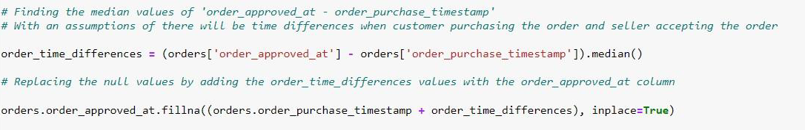
The imputation of these null values based on the median values of the differences, are made because of the assumptions that there are time differences between the time when the customer placed the order and the order get approved.
As well as times differences when the order was approved and delivered to the customers. It is impossible to ignore the differences and replace with any other values besides median.

Slide 6
There are NO null values and NO duplicates values exists in the orders column,
thus let’s process with the next data.
ORDER ITEMS
A. Analysing the attributes

Slide 7
There are No Missing Values, and No Duplicates Values in the dataset, thus let’s proceed further.
B. Analysing the Numerical features in the datasets

Slide 8
From the above data, we can infer that:
The mean for the price is 120.65, with the minimum value of 0.85 and maximum values at 6735.00. Obviously, there is an outliers present in the column, which will be treated in the next step.
For the shipping charges column, the mean value is at 19.99, minimum value with 0 charges and the maximum values at 409.68.

Slide 9
Analyzing the correlation between ‘price’ and ‘shipping charges’
From the regplot, it clearly indicates that price and shipping charges are positively correlated

Slide 10
The distplot for price and shipping charges are very important to determine the skewness of the data. Both of the variables are rightly skewed

Slide 11
C. Handling the outliers
1. Price
Boxplot has shown that there are an outliers present in the Price column, an equal distribution between the 1st quartile and the 3rd quartile. Mean value lies at 120.65.
We have decided to impute the value > 3000 to median value.

Slide 12
ii. Shipping Charges
We are imputing the shipping charges for the value > 100.
Before Imputation
After Imputation

Slide 13
CUSTOMERS
A. Analysing The Attributes
Customer’s dataset consists of 99441 rows with 4 columns.
There are NO NULL VALUES presents in this dataset

Slide 14
However, there are total of 3089 duplicates values present in this dataset. Thus, we dropped this duplicates values for our further analysis.
Final Data with NO missing
and duplicates values

Slide 15
PAYMENTS
A. Analysing The Attributes
The Payments datasets consists of 103886 rows and 5 columns. There are No Missing values and No duplicates values presents.
B. Visualizing the Payment Type

Slide 16
From the donut chart, we can infer that:
Most of the orders done by customers are through the Credit Card which is 73.9%. Followed closely by Wallet and Voucher with 19% and 5.56%.
There are some medium of payment which is not defined, for this we will drop the payment type as it will not affect our analysis later on.
C. Analysing the Numerical Features
All of the 3 graphs showed that the data are rightly skewed and there are outlier present in the dataset.

Slide 17
Final data for Payments do not have any missing values as well as duplicates values.
PRODUCTS
A. Analysing The Attributes
There are 32951 rows in the dataset and 6 columns
Out of 6 columns, 5 columns having missing values.

Slide 18
B. Handling the Missing Values
For the missing values in the product category name, we are imputing the missing values with the common value, which is mode. In this case, the missing values are replaced with ‘Toys’.
For the remaining missing values in the numerical columns, we are imputing those values by replacing it with the median values.

Slide 19
C. Analysing the Numerical features

Slide 20
All of the numerical columns are rightly skewed
This Retail dataset consists of 5 main sheets which includes orders, order_item, products, payments and customers.
All of the sheets are connected with the common value such as Order ID, product ID and customer ID.

Slide 21
Merging of the datasets are based on the following codes:

Slide 22
The final datasets after merging consists of 115035 rows and 24 columns. There are NO MISSING VALUES and NO DUPLICATES VALUES present in the dataset
MARKET BASKET ANALYSIS
We have created a separate dataframe for our Market Basket Analysis as follows:

Slide 23
Only the selected features such as order id, order item id and product category name are selected for this analysis.
The importance of this analysis is to determine on which items frequently bought together, hence will help Olist to come out with a future planning for their inventory cost.
Upon completing the Market Basket dataset, it has been finalized that this dataset consists of 115035 rows and 3 columns.
EXPORTING THE DATASET TO EXCEL
Once the data is cleaned, we have exported the dataset to excel (below code) before proceed further with our visualization in Tableau.
The insights we have gathered from our Tableau visualization as well as the recommendations, which can be implemented, have been compiled in a file called Executive Summary.
Exporting the cleaned dataset

Slide 24
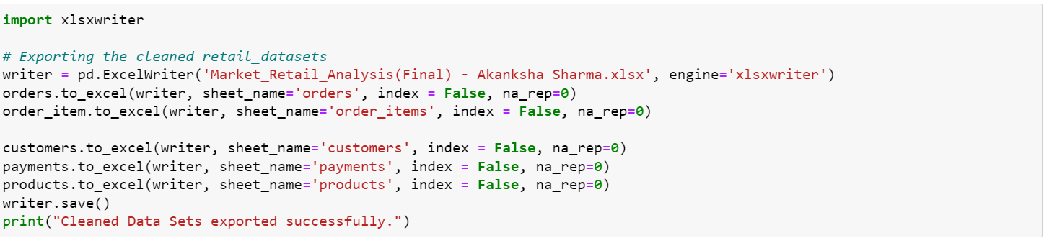
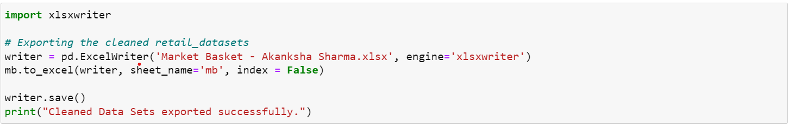

Exporting the market basket dataset
Thank You

